Slide 1
Data Science Project
Can we predict the extinction of a species?
by
Noy Benbenishty
Maor Aichenboim

Slide 2
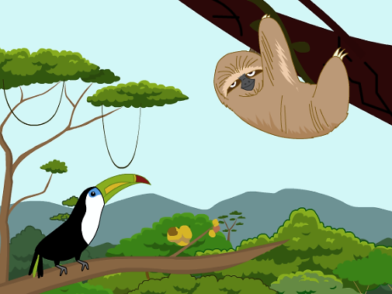
External Resources
Wikipedia
A-Z Animals
il.brainpop.com – Drawings
Google Search – photos

Slide 3
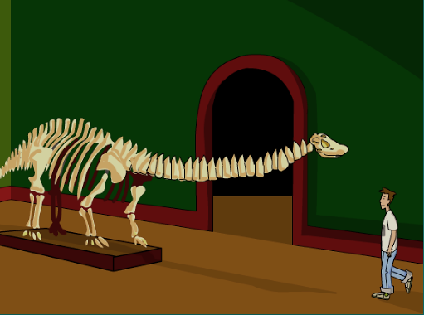
Data Extraction

Slide 4
Crawling and Scraping
Wikipedia:
Extracting specific data of the extinct animals from the main page tables.
Extracting the rest of the animal data from the animal's page link in the same crawl.
Creating an extinction specific Data-frame and saving it as a csv file.
A-Z Animals:
Extracting all of the animals page links from the main page to a Data-frame
Extracting all of the animals data by link .
Creating a Data-frame and saving it as a csv file.
Both crawlings used the same method of creating a properties and values list:
At the end of each iteration we created a specific animal DF from the lists and used append to merge all of them to a single DF.

Slide 5
The Merged Data Frame
[1739 Spices in total, 617 Extinct]
(showing the relevant properties only)
Conservation Status: Least Concern to Critically Endangered & Extinct
Phylum: 8 Unique Strings
Class: 21 Unique Strings
Order: 159 Unique Strings
Family: 360 Unique Strings
Scientific Name: Strings
Other Name(s): Strings
Diet: Omnivore, Herbivore, Carnivore
Common Name: Strings
Color: 562 Unique Strings (combinations)
Skin Type: 8 Unique Strings
Lifespan: Strings
Type: 101 Unique Strings.
Predators Strings
Conception Period: Strings
Locations: Strings
Threats: Strings
Birth rate: Strings

Slide 6
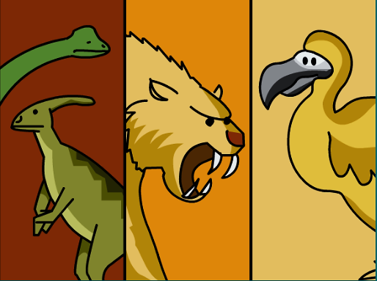
Data Handling

Slide 7
The Merged Data Frame
Conservation Status: Least Concern to Critically Endangered & Extinct No Change
Phylum: 8 Unique Strings Factorize
Class: 21 Unique Strings Factorize
Order: 159 Unique Strings Factorize
Family: 360 Unique Strings Factorize
Scientific Name: Strings No Change
Other Name(s): Strings No Change
Diet: Omnivore, Herbivore, Carnivore Factorize
Common Name: Strings No Change
Color: 562 Unique Strings (combinations) Factorize
Skin Type: 8 Unique Strings Factorize
Lifespan: Strings Text Analyze
Type: 101 Unique Strings Factorize
Predators Strings Text Analyze
Conception Period: Strings Text Analyze
Locations: Strings Text Analyze & Split
Threats: Strings Text Analyze & Split
Birth rate: Strings Text Analyze

Slide 8
Missing Data
Steps:
Dropping columns with a threshold of missing data.
Manually Dropping data-problematic\none-relevant columns.
Dividing the Data Frame by the “Class” property and further splitting by the “Order” property to a single DF in a loop. In each loop we filled the missing data of the most frequent element and merged the specific “Order” DF to create a new and full DF.
After handling missing data by “Order” we did the same by “Class” (the outer loop).

Slide 9
Data Conversions
Text:
Some properties of the data frame were a whole text of strings which was needed specific handling.
Each element(text) in the property column could have connected words and include 2 or more values.
For each property we created a list of words/connected-letters to search for a specific value,
looping in each text and checking if there is a string from the list in the text.
“Predators” – Changed to sum of predators.
"Locations” – Divided to columns by Continent and sum of locations.
"Threats” – Divided to columns by specific Threat and sum of threats.
“Lifespan”, “Birth rate” & “Conception Period” – Changed the string value into an integer.
“Skin type” – Replaced strings with the same meaning to a single string.
Categorical:
Columns with unique and limited elements were converted to numeric labels:
“Type”, “Skin Type”, “Color”, “Family”, “Order”, “Class” and “Phylum”.

Slide 10

Visualization And Analyzation

Slide 11
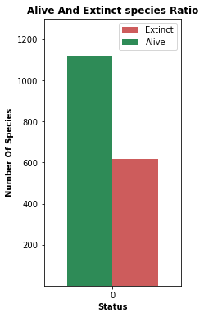
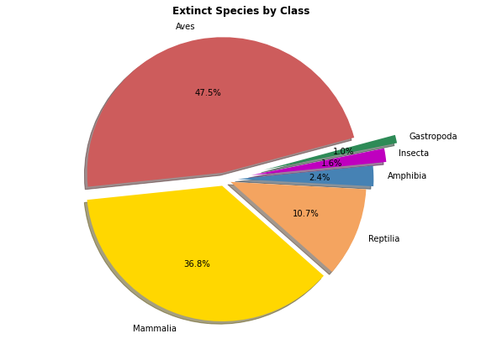
Getting To Know The Species

Slide 12
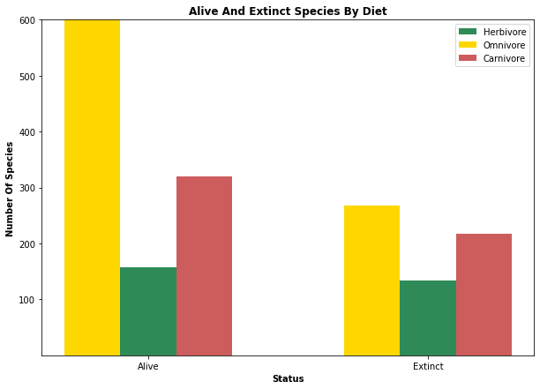
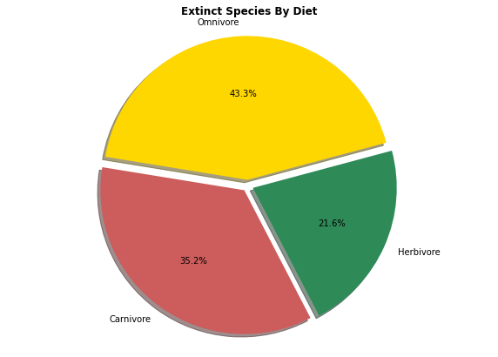
Getting To Know The Species

Slide 13
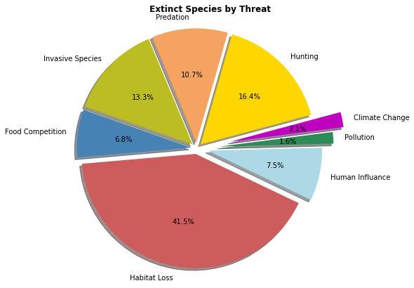
Extinct Species Distribution By Threat

Slide 14
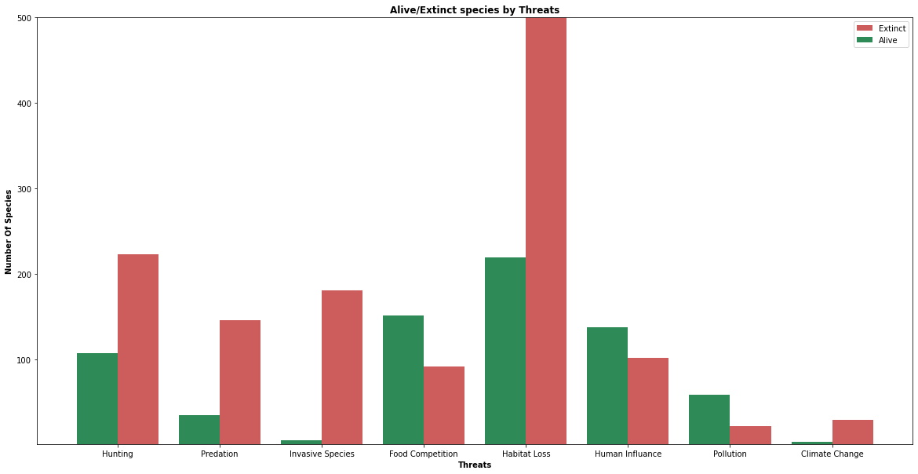
Species Distribution By Threat
As can be seen, the threat of habitat loss has a big impact on both extinct and alive species.
Another big influence comes from the invasive species threat, which the ratio between extinct and alive species is very large

Slide 15
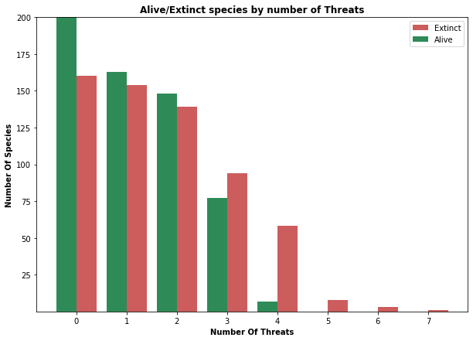
Species Distribution By Number Of Threat
According to the graph, as the number of threats grows, the amount of living species descends at a bigger pace then the extinct.
At 5 and above threats we can assume that species cannot survive and are headed for extinction.

Slide 16
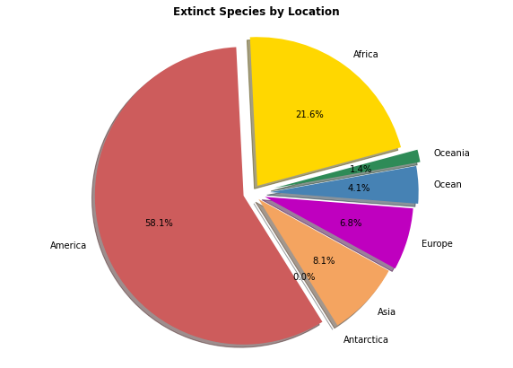
Extinct Species Distribution By Locations

Slide 17
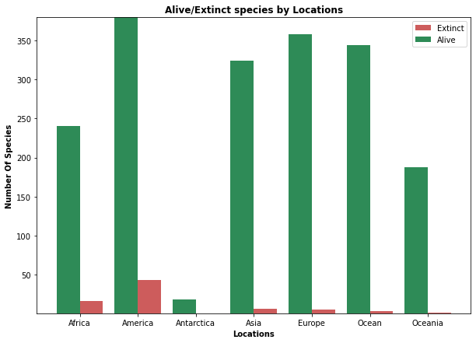
Species Distribution By Location
As can be seen, the largest amount of species are located in America, both in alive status and extinct.
Africa's living/extinct species ratio is larger then most.

Slide 18
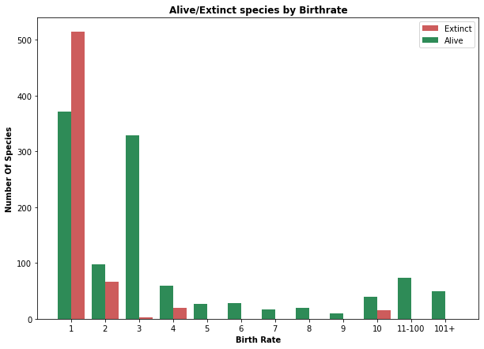
Species Distribution By Birth Rate
As can be seen, when the birth rate is 1 its easier for species to get extinct, as it depends of the survival of a single offspring.
The extinct ratio is still strong with 2 offsprings and at 3 and above the ratio declines to half and less.

Slide 19
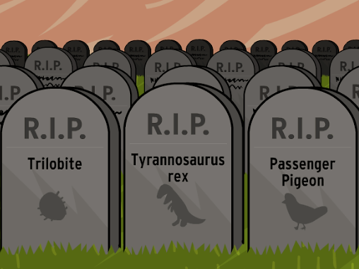
Machine Learning

Slide 20
Classification
Our label is “IsExtinct” column, because our research question refer to the prediction of the extinction of species – “Yes” or “No” question.
We chose to apply Logistic Regression – Supervised Learning for classification problems by a category label.
After training the model we got an accuracy of 92.24%.
In attempt to improve our accuracy even more we executed feature engineering, where we combined the “Birth Rate” and “Conception Period” columns.
Our final model accuracy is 93.96% .

Slide 21
The Process
Steps:
1. Cleaning the data frame:
We dropped all string columns from the Data Frame except “Scientific Name” which was converted to be the index column.
2. Executing the machine learning process:
Dividing our data frame to features and label (Status of “IsExtinct”).
Dividing the features and label to train and test (train = 80%, test = 20%).
Setting the Model Fit & Predict.
Getting the accuracy of the trained model.
3. Feature Engineering for better accuracy:
We created a new column by multiplying “Birth Rate” and “Conception Period”
that influence progeny birth directly.

Slide 22
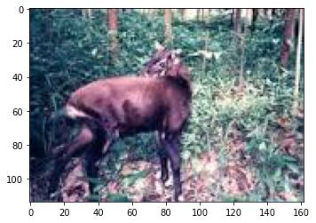
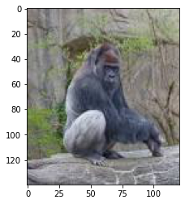
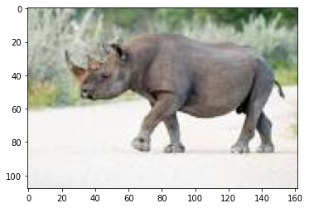
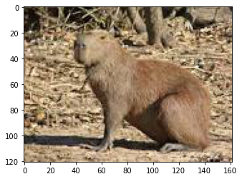
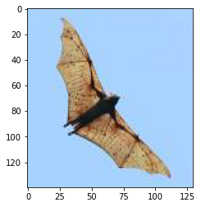
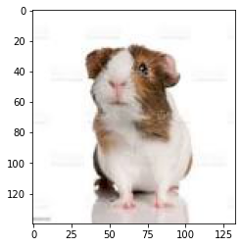
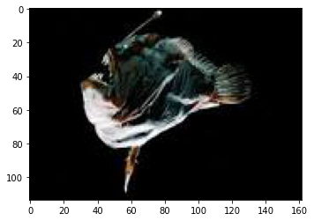
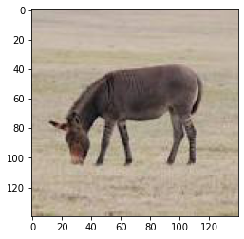
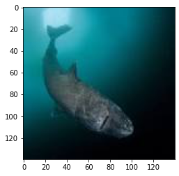
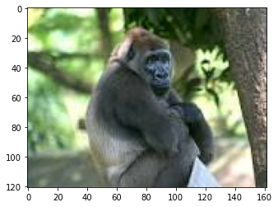
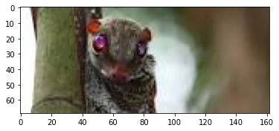
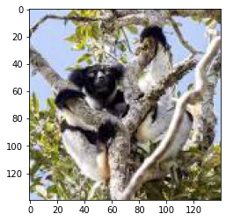
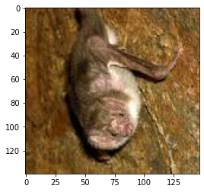
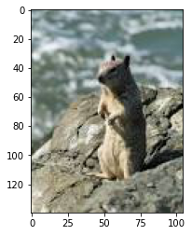
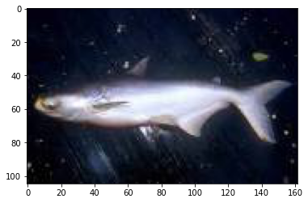
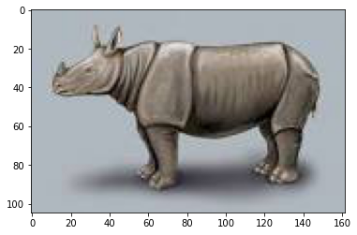
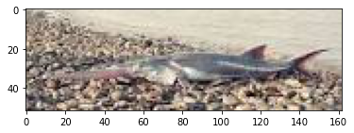
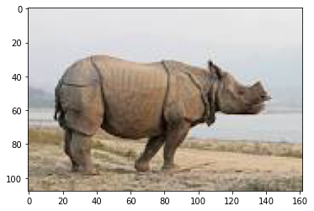
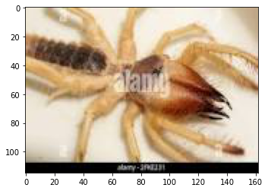
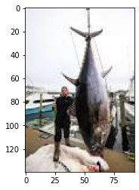
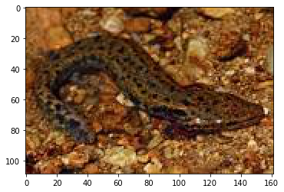
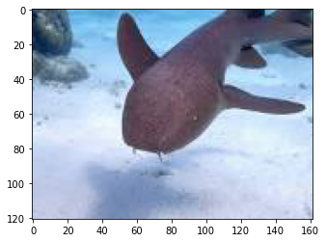
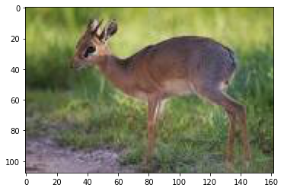
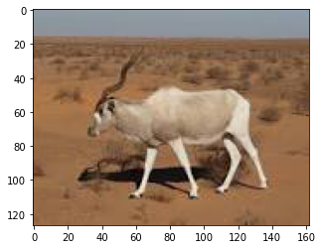
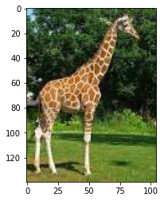
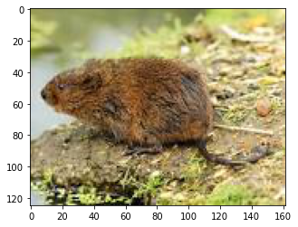
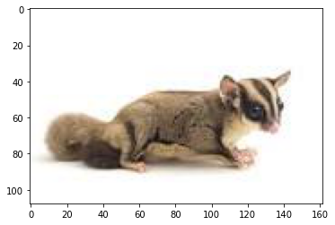
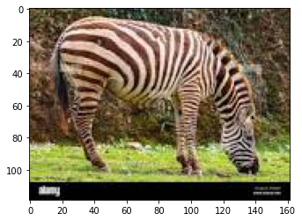
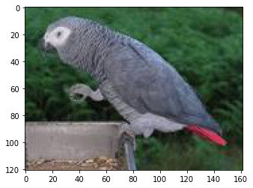
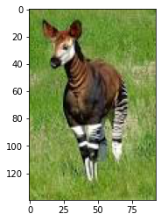
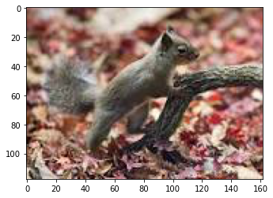
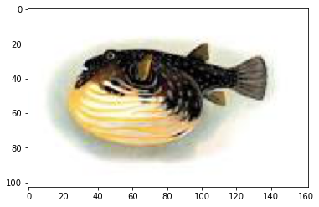
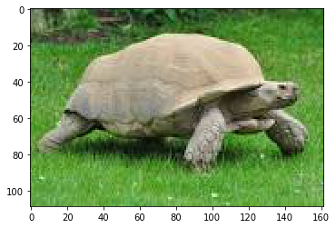
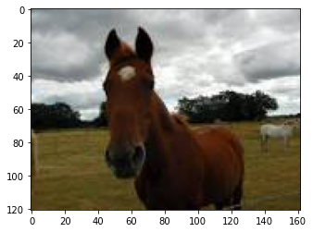
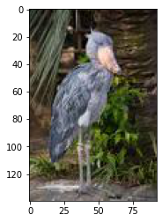
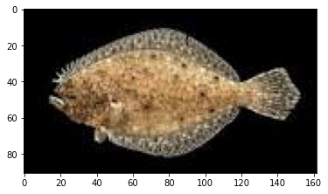








Conclusions
There are a large number of factors that influence extinction, the biggest impacts we found are the number of threats, which habitat-loss is above all, the species location, breeding factors and more, each with its own strength of influence.
While we succeeded in creating a model to predict the extinction of a species, there seems to be a big lack of data on them.
There are a lot more properties and variables that influence extinction which could improve the model greatly and have it create a more accurate and real-life like results.
Species to be Extinct by our model:

